Slide 1

VELAMMAL COLLEGE OF ENGINEERING AND TECHNOLOGY
FINAL REVIEW PRESENTATION
TITLE : Arduino Based Power Saving In Industrial Loads
Presented By: Hrithik Vel.B(913119105022)
Jeyvishnu V.BA(913119105028)
Vijay KrishnaT.K.B (913119105304)
Guided By : Dr.S.Chellam M.E,Ph.D AP III/Dept of EEE, VCET
Date :17-06-2022,Friday

Slide 2
Abstract
To minimize the energy consumption and thus reduce the power loss in industries and establishments.
Reduces the electricity bill in industries and establishments.

Slide 3
Literature Survey
Sl.NO | Journal Paper | Author | Title | Description
1 | International research journal of engineering and technology(IRJET) | Dr.Sukhdeo Sao and K.Prasada Rao | Power saver for industrial and commercial establishments by power factor compensation (2019) | Proposed system the lag between zero voltage and zero current pulse duly generated by Suitable operational amplifier modes are fed to two interrupt pins of microcontroller.
2 | International journal of scientifc research and engineering development | Swapnil Namekar and Tushar Sawle | Experimental study on power saver establishment for commercial purpose(2020) | By Installing suitable size power capacitor into circuit the facility factor is improved and therefore the values becomes nearer to 0.9 to 0.95 has minimizing line losses.
3 | International journal of advanced engineering and research development | Mr.Jadhav Rohit, Mr.Bhor Ashish and Miss Handore Saloni | Power saver for industrial and commercial establishment(2018) | The program takes over to actuate shunt capacitors into load circuit to get zero power loss by using 8051 microcontroller.

Slide 4
Problem Identification
In existing power saver methods, Microcontroller based controlling has been employed.
In microcontroller the number of execution is limited due to low memory and it has complex structure.
In proposed system arduino has more memory, easy interfacing, consumes less power compared to other microcontrollers.

Slide 5
Block Diagram
Device 1
4 Channel Relay
Arduino
Device 2
220 V AC
Device 3
External 5 Volts

Slide 6
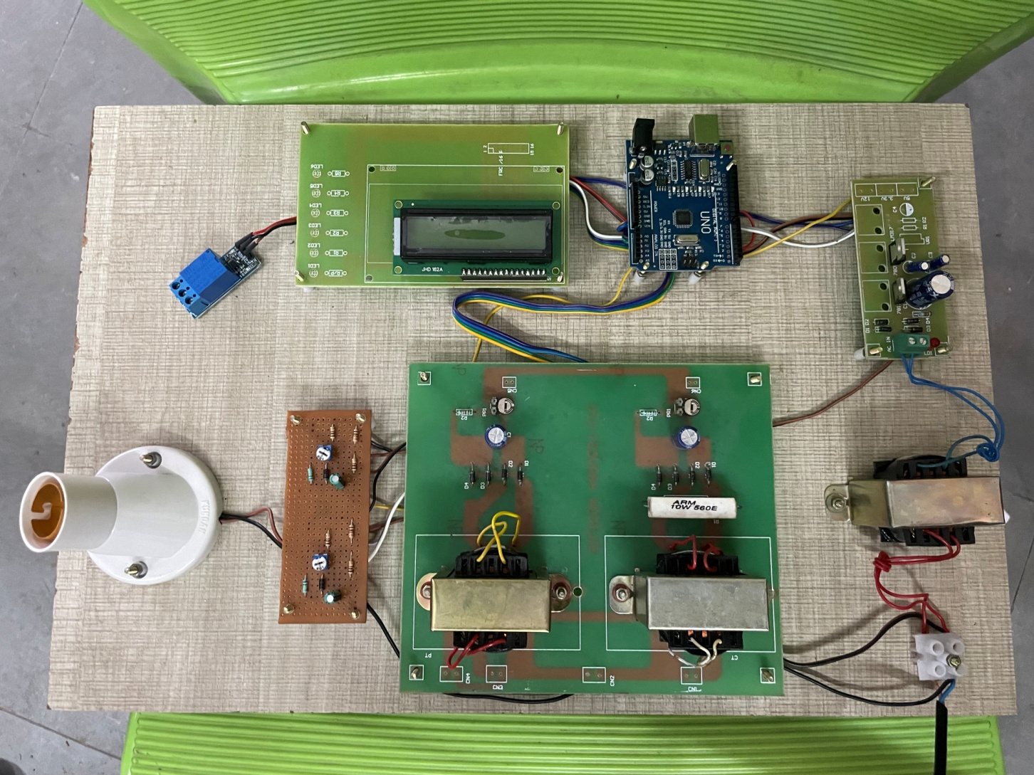
Output and Results

Slide 7
Work Accomplished
We have identified the proper components and finished our project.
We have presented our paper in Two day national conference on sustainable infrastructure with responsible consumption and production conducted by civil department on 25.03.22

Slide 8
Cost Estimation
The Estimated Cost of our project is around ₹2000
NAME OF THE COMPONENT | PRICE
Arduino | 900
Shunt capacitors | 450
Relays | 150
Inductive load | 100

Slide 9
ADVANTAGES OF THIS PROJECT
Savings on monthly electric bill are very significant. More KW working power for the same KVA demand Released system capacity allows for additional motors, lighting, etc. To be added without overloading existing distribution equipment Improved voltage regulation due to reduced line voltage drop More efficient performance of equipment and motors Lower operating temperatures Reduction in the size of transformers, cables and switchgears in new construction so you save capital.

Slide 10
Conclusion
The project program controls the working and actuates required number of relays from the output that will get shunt capacitors into load circuit in order to get power factor until it reaches unity.
An Arduino fulfils this process.

Slide 11
Scope Of The Project
Our modern world of electronics requires a lot of energy. To meet this demand, energy must be stored electrically for easy access.
Capacitors are ideal for storing large electrical energy charges as well as conditioning the flow of energy as needed.

Slide 12
References
[1]Dr.Sukhdeo Sao and K.Prasada Rao-Power saver for industrial and commercial establishments by power factor compensation-International research journal of engineering and technology(IRJET)-PP.2806-2812-Volume:06 Issue:04-April 2019.
[2]Swapnil Namekar and Tushar Sawle-Experimental study on power saver establishment for commercial purpose-International journal of scientific research and engineering development-PP.732-734-Volume:03 Issue:02-March-April-2020.
[3]Mr.Jadhav Rohit, Mr.Bhor Ashish and Miss Handore Saloni-Power saver for industrial and commercial establishment-International journal of advanced engineering and research development-PP.667-672-Volume:05 Issue:05-May 2018.
[4]Vishal Vaibhav and Varsha Mehar-A review on power saver establishments for industrial and commercial purpose-International journal of engineering sciences and research technology-PP.107-113-Volume:07 Issue:09-September2019.
[5]Mr.Naryanan Swamy.R and Dr.G.Mahadevan-Power Saving Device-International journal of scientific and technology research-PP.14-16-Volume: Issue-August 2012.

Slide 13
THANK YOU

